Slide 1
Therapeutic Updates in Melanoma: IO for Earlier Stage Disease
David M. Miller MD, PhD, FAAD
Division of Hematology/Oncology and Department of Dermatology
Massachusetts General Hospital
Orlando Dermatology and Aesthetics Conference
January 18, 2020

Slide 2


Disclosures
I have received honoraria from Pfizer, Merck Sharpe & Dome, Regeneron and Sanofi Genzyme for participation on advisory boards
A TEACHING HOSPITAL OF HARVARD MEDICAL SCHOOL

Slide 3
Learning Objectives
Describe the current indications of Immune-Checkpoint Inhibitors in patients with melanoma
Understand evolving treatment strategies for patients with earlier stage melanoma
Identify patients for whom Immune-Checkpoint Inhibitor therapy may be appropriate
A TEACHING HOSPITAL OF HARVARD MEDICAL SCHOOL

Slide 4
Approved Therapies for Advanced Melanoma
Sylatron (Peg-IFN-alfa-2b) for adjuvant
Tafinlar
(Dabrafenib)
------------------
Mekinist
(Trametinib)
For Stage IV
Yervoy (Ipilimumab) as Adjuvant
Combination Encorafenib & Benimetinib For Stage IV Dz
Imlygic
(talimogene laherparepvec)
DTIC
(Dacarbazine)
Aldesleukin
(IL-2)
Yervoy (Ipilimumab) for Stage IV Dz
Opdivo
(Nivolumab) for Stage IV
Opdivo (Nivolumab) for Adjuvant
December
1967
December
1995
August
2011
Sept.
2014
Sept.
2015
Nov 2015
April 2018
Feb.
2019
May
1975
January
1998
March 2011
May 2013
Dec.
2014
Oct 2015
Dec
2017
June
2018
Hydrea (Hydroxyurea)
Intron A
(Interferon-α2b) for Adjuvant
Zelboraf (Vemurafenib)
Keytruda
(Pembrolizumab)
Combination Dabrafenib &
Trametinib for Adjuvant Dz
Ipilimumab & Nivolumab in Combination for Systemic Dz
Keytruda
(Pembrolizumab)
as adjuvant Tx
Combination Dabrafenib &
Trametinib for Systemic Dz
------------------
Combination Vemurafenib & Combimetinib for Syst Dz
Notes:
29 approvals in melanoma

Slide 5
Approved Therapies for Advanced Melanoma
Sylatron (Peg-IFN-alfa-2b) for adjuvant
Yervoy (Ipilimumab) as Adjuvant
Tafinlar
(Dabrafenib)
------------------
Mekinist
(Trametinib)
For Stage IV
Combination Encorafenib & Benimetinib For Stage IV Dz
Imlygic
(talimogene laherparepvec)
DTIC
(Dacarbazine)
Aldesleukin
(IL-2)
Yervoy (Ipilimumab) for Stage IV Dz
Opdivo
(Nivolumab) for Stage IV
Opdivo (Nivolumab) for Adjuvant
December
1967
December
1995
August
2011
Sept.
2014
Sept.
2015
Nov 2015
April 2018
Feb.
2019
May
1975
January
1998
March 2011
May 2013
Dec.
2014
Oct 2015
Dec
2017
June
2018
Hydrea (Hydroxyurea)
Intron A
(Interferon-α2b) for Adjuvant
Zelboraf (Vemurafenib)
Keytruda
(Pembrolizumab)
Combination Dabrafenib &
Trametinib for Adjuvant Dz
Ipilimumab & Nivolumab in Combination for Systemic Dz
Keytruda
(Pembrolizumab)
as adjuvant Tx
Immune-Directed Therapy
Combination Dabrafenib &
Trametinib for Systemic Dz
------------------
Combination Vemurafenib & Combimetinib for Syst Dz
Oncogene-Directed Therapy
Notes:
Nevertheless, these data were strong enough to led to the approval of two BRAFi and one MEKi

Slide 6

SCF
SCF
c-KIT
P
P
Shc
RAS
NF1
RAS
P
P
GDP
GTP
Grb2
SOS
Encorafenib
Dabrafenib
BRAF
V600
Vemurafenib
Benimetinib
Trametinib
MEK
Cobimetinib
ERK
Cell Proliferation
Notes:
Although more than 40 different mutations in BRAF have been described,3 the most clinically relevant mutation is the BRAFT1799A, which results in the substitution of valine by glutamic acid (V600E) in the kinase domain of the protein. 90% of the clinically relevant mutations are V600E; 10% are V600K, where valine is changed to lysine

Slide 7
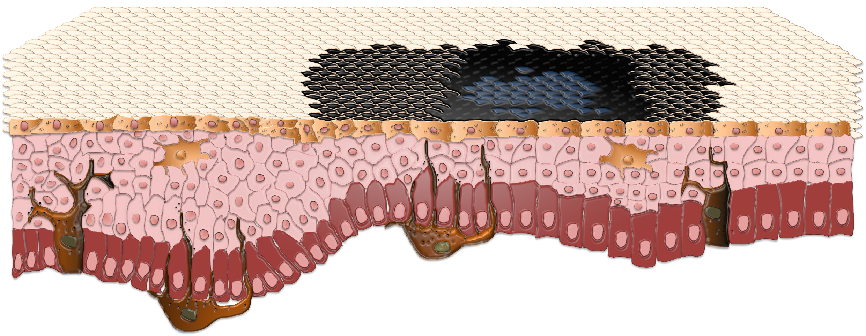


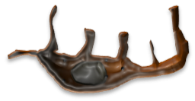

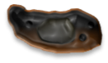
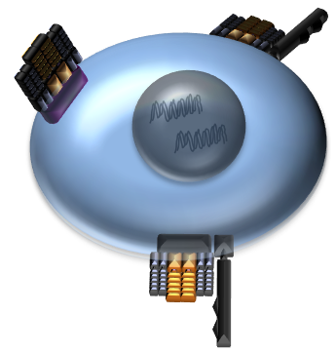
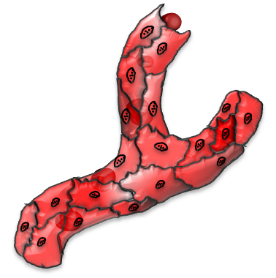



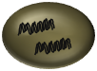



Immune Checkpoints
PD-1
Nivolumab
Pembrolizumab
CTLA4
PD-L1
Ipilimumab
CD80/86

Slide 8
Approved Therapies for Advanced Melanoma
Sylatron (Peg-IFN-alfa-2b) for adjuvant
Yervoy (Ipilimumab) as Adjuvant
Tafinlar
(Dabrafenib)
------------------
Mekinist
(Trametinib)
For Stage IV
Combination Encorafenib & Benimetinib For Stage IV Dz
Imlygic
(talimogene laherparepvec)
DTIC
(Dacarbazine)
Aldesleukin
(IL-2)
Yervoy (Ipilimumab) for Stage IV Dz
Opdivo
(Nivolumab) for Stage IV
Opdivo (Nivolumab) for Adjuvant
December
1967
December
1995
August
2011
Sept.
2014
Sept.
2015
Nov 2015
April 2018
Feb.
2019
May
1975
January
1998
March 2011
May 2013
Dec.
2014
Oct 2015
Dec
2017
June
2018
Hydrea (Hydroxyurea)
Intron A
(Interferon-α2b) for Adjuvant
Zelboraf (Vemurafenib)
Keytruda
(Pembrolizumab)
Combination Dabrafenib &
Trametinib for Adjuvant Dz
Ipilimumab & Nivolumab in Combination for Systemic Dz
Keytruda
(Pembrolizumab)
as adjuvant Tx
Immune-Directed Therapy
Combination Dabrafenib &
Trametinib for Systemic Dz
------------------
Combination Vemurafenib & Combimetinib for Syst Dz
Oncogene-Directed Therapy
Notes:
Nevertheless, these data were strong enough to led to the approval of two BRAFi and one MEKi

Slide 9
Approved Therapies for Advanced Melanoma
Sylatron (Peg-IFN-alfa-2b) for adjuvant
Yervoy (Ipilimumab) as Adjuvant
Tafinlar
(Dabrafenib)
------------------
Mekinist
(Trametinib)
For Stage IV
Combination Encorafenib & Benimetinib For Stage IV Dz
Imlygic
(talimogene laherparepvec)
DTIC
(Dacarbazine)
Aldesleukin
(IL-2)
Yervoy (Ipilimumab) for Stage IV Dz
Opdivo
(Nivolumab) for Stage IV
Opdivo (Nivolumab) for Adjuvant
December
1967
December
1995
August
2011
Sept.
2014
Sept.
2015
Nov 2015
April 2018
Feb.
2019
May
1975
January
1998
March 2011
May 2013
Dec.
2014
Oct 2015
Dec
2017
June
2018
Hydrea (Hydroxyurea)
Intron A
(Interferon-α2b) for Adjuvant
Zelboraf (Vemurafenib)
Keytruda
(Pembrolizumab)
Combination Dabrafenib &
Trametinib for Adjuvant Dz
Ipilimumab & Nivolumab in Combination for Systemic Dz
Adjuvant Therapy
Keytruda
(Pembrolizumab)
as adjuvant Tx
Immune-Directed Therapy
Combination Dabrafenib &
Trametinib for Systemic Dz
------------------
Combination Vemurafenib & Combimetinib for Syst Dz
Oncogene-Directed Therapy
Notes:
Nevertheless, these data were strong enough to led to the approval of two BRAFi and one MEKi

Slide 10
Approved Therapies for Advanced Melanoma
Tafinlar
(Dabrafenib)
------------------
Mekinist
(Trametinib)
For Stage IV
Yervoy (Ipilimumab) for Stage IV Dz
Opdivo
(Nivolumab) for Stage IV
Sept.
2014
Sept.
2015
March 2011
May 2013
Dec.
2014
Keytruda
(Pembrolizumab)
Ipilimumab & Nivolumab in Combination for Systemic Dz
Adjuvant Therapy
Immune-Directed Therapy
Oncogene-Directed Therapy
Notes:
Nevertheless, these data were strong enough to led to the approval of two BRAFi and one MEKi

Slide 11
COMBI-d & COMBI-v 5 Year OS Data
Dabrafenib plus trametinib
Robert et al. NEJM 2019
A TEACHING HOSPITAL OF HARVARD MEDICAL SCHOOL
Notes:
Patients who received first-line therapy as above

Slide 12
KEYNOTE-006 5 Year OS Data
Pembrolizumab
Ipilimumab
38.7 months
17.1 months
HR: 0.73 (95% CI 0.57-0.92)
Robert et al. Lancet Oncology 2019
A TEACHING HOSPITAL OF HARVARD MEDICAL SCHOOL
Notes:
Patients who received first-line therapy as above

Slide 13
CheckMate-067 5 Year OS Data
Nivolumab plus Ipilimumab
Nivolumab
Ipilimumab
52% 5-year OS
44% 5-year OS
26% 5-year OS
Larkin et al. NEJM 2019
A TEACHING HOSPITAL OF HARVARD MEDICAL SCHOOL

Slide 14
Therapy for Resected Disease
Sylatron (Peg-IFN-alfa-2b) for adjuvant
Yervoy (Ipilimumab) as Adjuvant
Opdivo (Nivolumab) for Adjuvant
December
1995
April 2018
Feb.
2019
March 2011
Oct 2015
Dec
2017
Intron A
(Interferon-α2b) for Adjuvant
Combination Dabrafenib &
Trametinib for Adjuvant Dz
Adjuvant Therapy
Keytruda
(Pembrolizumab)
as adjuvant Tx
Notes:
Nevertheless, these data were strong enough to led to the approval of two BRAFi and one MEKi

Slide 15
Therapy for Resected Disease
Yervoy (Ipilimumab) as Adjuvant
Opdivo (Nivolumab) for Adjuvant
April 2018
Feb.
2019
Oct 2015
Dec
2017
Combination Dabrafenib &
Trametinib for Adjuvant Dz
Adjuvant Therapy
Keytruda
(Pembrolizumab)
as adjuvant Tx
Notes:
Nevertheless, these data were strong enough to led to the approval of two BRAFi and one MEKi

Slide 16
EORTC 18071: Ipilimumab vs. Placebo
Ipilimumab
Placebo
65.4% 5-year OS
54.4% 5-year OS
HR: 0.72 (95% CI 0.58-0.88)
Eggermont et al. NEJM 2016
A TEACHING HOSPITAL OF HARVARD MEDICAL SCHOOL

Slide 17
CheckMate 238: Nivolumab vs. Ipilimumab
Nivolumab
Ipilimumab
70.5% 1-year RFS
60.8% 1-year RFS
HR: 0.65 (95% CI 0.51-0.83)
Weber et al. NEJM 2017
A TEACHING HOSPITAL OF HARVARD MEDICAL SCHOOL

Slide 18
KEYNOTE-054: Pembrolizumab vs. Placebo
Pembrolizumab 75.4% 1-year RFS
Placebo 61.0% 1-year RFS
HR: 0.57 (95% CI 0.43-0.74)
Eggermont et al. NEJM 2018
A TEACHING HOSPITAL OF HARVARD MEDICAL SCHOOL

Slide 19
COMBI-AD: Dabrafenib/Trametinib vs. Placebo
Dabrafenib/Trametinib 54% 4-year RFS
Placebo 38% 4-year RFS
HR: 0.49 (95% CI 0.40-0.59)
Hauschild et al. JCO 2018
A TEACHING HOSPITAL OF HARVARD MEDICAL SCHOOL

Slide 20
Options for Resected Disease
Stage III/IV
Pembrolizumab or Nivolumab for BRAF WT and V600 mutant
Dabrafenib/Trametinib, Pembrolizumab or Nivolumab for BRAF V600 mutant
Ipilimumab, Interferon for BRAF WT and V600 mutant
A TEACHING HOSPITAL OF HARVARD MEDICAL SCHOOL

Slide 21
Prognosis
Stage I-II
Stage III
A TEACHING HOSPITAL OF HARVARD MEDICAL SCHOOL
Gershenwald. CA Cancer J Clin. 2017.

Slide 22
Systemic Therapy for Stage II Disease
KEYNOTE-716
A TEACHING HOSPITAL OF HARVARD MEDICAL SCHOOL

Slide 23


KEYNOTE-716 Study Design
Adjuvant Therapy
Rechallenge/Crossover
Participants:
≥12 years old
Resected Stage IIB or IIC
(N=954)
Pembrolizumab
q3 weeks
17 cycles
Recurrence
Unblind
Pembrolizumab
R 1:1
17 cycles for local/distant recurrence following surgical resection
Placebo
q3 weeks
17 cycles
35 cycles for unresectable Dz
A TEACHING HOSPITAL OF HARVARD MEDICAL SCHOOL
Clinicaltrials.gov NCT03553836

Slide 24
NeoAdjuvant Therapy for Melanoma: Advantages
Might reduce tumor burden and facilitate resection
Provides potentially valuable information regarding response
Provides insights into mechanisms of resistance and response
Enables identification of biomarkers for response and survival
A TEACHING HOSPITAL OF HARVARD MEDICAL SCHOOL

Slide 25
OpACIN Study Design
NeoAdjuvant Therapy
Adjuvant Therapy
Ipilimumab plus Nivolumab
2 cycles
Surgery
Ipilimumab plus Nivolumab
(2 cycles)
Resectable macroscopic stage III melanoma (N=20)
R 1:1
No Therapy
Ipilimumab plus Nivolumab
(4 cycles)
A TEACHING HOSPITAL OF HARVARD MEDICAL SCHOOL
Blank et al. Nature Medicine 2018; Clinicaltrials.gov NCT02437279

Slide 26
OpACIN Relapse-Free Survival
Toxicity
Neoadjuvant/Adjuvant 2/10 relapsed
Adjuvant Only 4/10 relapsed
90% Grade III/IV AEs
90% Grade III/IV AEs
A TEACHING HOSPITAL OF HARVARD MEDICAL SCHOOL
Blank et al. Nature Medicine 2018; Clinicaltrials.gov NCT02437279
Notes:
Grade 3 events: 90% in the surgery only group vs. 90% in the neoadjuvant plus surgery

Slide 27
Ipi/Nivo vs. Nivo Neoadjuvant Study Design
NeoAdjuvant Therapy
Adjuvant Therapy
Ipilimumab plus Nivolumab
3 cycles; N = 11
Surgery
Nivolumab
13 cycles
Resectable stage III/IV melanoma (N=21)
Nivolumab
4 cycles
N = 12
Nivolumab
13 cycles
A TEACHING HOSPITAL OF HARVARD MEDICAL SCHOOL
Amaria et al. Nature Medicine 2018; Clinicaltrials.gov NCT02519322

Slide 28
Ipi/Nivo vs. Nivo Neoadjuvant RFS/ORR/pCR
Toxicity
Neoadjuvant Ipi/Nivo 81% RFS; 73% ORR; 45% pCR
Neoadjuvant Nivo 56% RFS; 25% ORR; 25% pCR
73% Grade III AEs
8% Grade III AEs
A TEACHING HOSPITAL OF HARVARD MEDICAL SCHOOL
Amaria et al. Nature Medicine 2018; Clinicaltrials.gov NCT02519322
Notes:
Pathological complete response: 25% participants in the nivolumab-only group vs 45% participants in the ipilimumab plus nivolumab group
Nivolumab-only: 8% participants had grade 3 adverse events; ipilimumab plus nivolumab: 73% participants had grade 3 adverse events; no grade 4 or 5 events in any group

Slide 29


OpACIN-neo Study Design
NeoAdjuvant Therapy
Ipilimumab 3 mg/kg plus
Nivolumab 1 mg/kg
x 2 cycles; N = 30
Surgery
Resectable stage III melanoma (N=86)
Ipilimumab 1 mg/kg plus
Nivolumab 3 mg/kg
x 2 cycles; N = 30
Ipilimumab 3 mg/kg x 2 cycles
followed by Nivolumab 3 mg/kg
x 2 cycles; N = 26
A TEACHING HOSPITAL OF HARVARD MEDICAL SCHOOL
Rozeman et al. Lancet Oncology 2019; Clinicaltrials.gov NCT02977052

Slide 30
OpACIN-neo Recurrence-Free Survival
Toxicity
Ipi 3 mg/kg with Nivo 1 mg/kg
Ipi 1 mg/kg with Nivo 3 mg/kg
Ipi 3 mg/kg followed by Nivo 3 mg/kg
40% Grade III/IV AEs
20% Grade III/IV AEs
50% Grade III/IV AEs
A TEACHING HOSPITAL OF HARVARD MEDICAL SCHOOL
Rozeman et al. Lancet Oncology 2019; Clinicaltrials.gov NCT02977052

Slide 31
COMBI-NEO Study Design
NeoAdjuvant Therapy
Adjuvant Therapy
Dabrafenib plus Trametinib
8 weeks; N = 14
Surgery
Dabrafenib plus Trametinib
44 weeks
Resectable stage III/IV BRAF V600E/K mutated melanoma (N=21)
R 2:1
No Therapy; N = 7
Optional adjuvant
therapy
A TEACHING HOSPITAL OF HARVARD MEDICAL SCHOOL
Amaria et al. Lancet Oncology 2018; Clinicaltrials.gov NCT02231775

Slide 32
COMBI-NEO Event-Free Survival
Neoadjuvant D/T 19.7 months mEFS
Standard of care 2.97 months mEFS
HR: 0.016 (95% CI 0.00012-0.14)
A TEACHING HOSPITAL OF HARVARD MEDICAL SCHOOL
Amaria et al. Lancet Oncology 2018
Notes:
Most common grade III AE was diarrhea (15%)

Slide 33
Neo-Combi Study Design
NeoAdjuvant Therapy
Adjuvant Therapy
Resectable stage IIIB-C BRAF V600 mutated melanoma (N=35)
Dabrafenib plus Trametinib
12 weeks
Surgery
Dabrafenib plus Trametinib
40 weeks
A TEACHING HOSPITAL OF HARVARD MEDICAL SCHOOL
Long et al. Lancet Oncology 2019 Clinicaltrials.gov NCT01972347

Slide 34
Neo-Combi Results
49% of patients had a pCR
29% of patients had Grade III/IV AEs
A TEACHING HOSPITAL OF HARVARD MEDICAL SCHOOL
Long et al. Lancet Oncology 2019 Clinicaltrials.gov NCT01972347

Slide 35
NeoAdjuvant Therapy for Melanoma: Considerations
Need to clearly define the ideal patient population
Need to identify optimal duration of treatment
Need to define toxicity profile
A TEACHING HOSPITAL OF HARVARD MEDICAL SCHOOL

Slide 36
International Neoadjuvant Melanoma Consortium
A TEACHING HOSPITAL OF HARVARD MEDICAL SCHOOL
Amaria et al. Lancet Oncology 2019

Slide 37
Summary
Immune-Checkpoint Inhibitors and Oncogene-Targeted Therapies demonstrate substantial activity in the late–stage disease
Newer approaches including Neoadjuvant and Adjuvant strategies aim to improve outcomes in patients with both high-risk locoregional and resectable metastatic disease
Early referral to medical oncology for consideration of systemic therapy may be appropriate for high-risk stage II as well as stage III melanoma
A TEACHING HOSPITAL OF HARVARD MEDICAL SCHOOL

Slide 38
Acknowledgements
Center for Melanoma - Massachusetts General Hospital
Orlando Dermatology and Aesthetics Conveference
A TEACHING HOSPITAL OF HARVARD MEDICAL SCHOOL

